Slide 1
Links:
IBM Circuit Composer: https://quantum-computing.ibm.com/
DTQC Quantum Hub for Games: http://quantum-hub.herokuapp.com/app/tsp
Github pull + sign up to server (only use once upon sign up):
http://34.145.36.19/hub/user-redirect/git-pull?repo=https%3A%2F%2Fgithub.com%2FWaywardPhoton%2FSTEMNYC&urlpath=tree%2FSTEMNYC%2F&branch=master
Server ip:
34.145.36.19

Slide 2
Action Items:
1.Develop slide deck (5-10s) outlining global problems in the process of being solved using quantum computing. Cover some basic NP problems (SAT, Graph Coloring, factoring). Explain how quantum advantage comes in, and limitations.
2. Develop slides to outline what quantum annealing is, how it works (use animations?), and briefly explain D-Wave’s architecture. Some notable D-Wave projects such as the Volkswagen car-painting. Highlight difference between annealing and actual QC.
3. Interactive project: zero-sum subset problem.
4. Develop slide deck (1-2s) for shortest paths map activity. Get participants to try and find the shortest route, then allow them to explore the D-Wave solver and see who got it right!
5. Develop structure (1s) for Dragons Den Pitch.
“Research types of problems that can be solved (optimization, search, constraint satisfaction) and choose a current problem that you think can be solved with QC. Explain breakdown of problem components and ways in which they can be solved.” (Zhanna)
Action Items
Notes:
Idea for high school activities: research types of problems that can be solved (optimization, search, constraint satisfaction) and choose a current problem that you think can be solved with QC. Explain breakdown of problem components and ways in which they can be solved.
Volkswagen painting cars using D-Wave annealer
Articles showing both sides of the coin: timeline of real QCs
Dragon’s Den pitch on quantum computing applications
Add plugin for podcast with John Martinez (google)

Slide 3
Action Items
1. Dragon’s Den Pitches (after lunch) : 60 second pitch presentation per group (Zhanna)
2. Develop interactive slides to introduce ongoing QC hardware research of IBM, Google, and Microsoft teams. Cover established: ion-trap, superconducting as well as new (topological qubits) and achievements
3. Develop interactive activity: polarized light experiment. Introduce concept of superposition and basis by stacking polarized filters. (Fernand)
4. Develop slide deck (5-10s) for qualitative, high-level intro to entanglement and superposition using linear algebra
?Introduce the Double Slit experiment, teleportation, and the Bell Inequality to get a sense of ‘quantum weirdness’. [not enough time]
ACTION ITEMS

Slide 4
Action Items
1. Develop interactive notebook that introduces Bloch sphere and state representation, beyond the simple ‘u,d,l,r’ that has been used previously. This can be animated using the Bloch sphere package.
2. Develop interactive notebook for introduction to single and two-qubit quantum gates. Explain layout of quantum circuits and give 15-20 mins exploration time on the IBMQ Circuit Composer.
3. Develop slide deck (max 5s) for challenge (single or group) activity to solve, using the circuit composer, a set of increasingly tricky circuit challenges. _______________________________________________________
4. Develop slide deck introducing the concept of a computer algorithm and layout steps to solving a problem, from formulation to mapping algorithm onto bits using a circuit, to results generation. Discuss noise and limitations of real-life systems.
5. Develop workbook activity: Interactive python code for Grover’s algorithm to solve (how much of this should be a fill-in exercise, and how much should be ready-made?)
ACTION ITEMS
Notes:
From common core math standards: matrix multiplication, 2x2 matrices. Can introduce matrices in the context of transforming qubit states on Bloch sphere: this incorporates learning standards into QC quite well. “Work with matrices as transformations of vectors”.
Group discussion should be earlier in the day.
Shared document with multiple contributors and shared answers to a prompt (running questions?)

Slide 5
Introduction to Quantum Computing
UBC Geering Up
STEM Teachers NYC

Slide 6


Introductions
From STEMTeachersNYC
Fernand Brunschwig, and
Zhanna Glazenburg
From UBC Geering Up
Ana Ciocoiu, and
Sarah Reny

Slide 7

In the chat, feel free to share with everyone your name, your pronouns, what subject and grade(s) you teach, and what you are hoping to leave this workshop with!
Who are you?

Slide 8

Use the Jamboard!
“I have questions!!!”
Notes:
We recognize that this is a brand new topic for many of you! We imagine that many questions may arise throughout the next couple of days and we want to ensure we address as many as we can.
Jamboard Link: https://jamboard.google.com/d/1hOP3clsqb6FcUipw7HDkUBBDc-cMHjmWkIVFYt-irs8/edit?usp=sharing

Slide 9
Day 1 Overview
Zhanna Fernand Sarah Ana
Day 1 | Time | Type
Intro to Qubits | 11 - 11:20 | Lecture
Superposition Exp | 11:20 - 11:30 | Lecture
Shortest Paths | 11:30 - 11:45 | Group Activity
Quantum Annealing | 11:45 – 12:00 | Lecture
Zero Sum Subsets | 12:00-12:30 | Group Activity
Lunch Break | --
Question Period | 2:00 - 3:00 | (Optional)
Shark Tank Pitches | 3:00-3:20 | Group activity
Types of QC | 3:20-3:40 | Lecture
Photonic QC | 3:40-4:00 | Guest Lecture
Wavefunctions | 4:00-4:30 | Lecture + Interactive Workbook

Slide 10
Day 2 Overview
Day 2 | Time | Type
Math Toolkit | 11 - 11:20 | Lecture + Interactive Workbook
Superposition | 11:20- 11:40 | Lecture + Interactive Workbook
Bloch Sphere | 11:40 – 12:00 | Group Activity
Quantum Circuits | 11:20 – 12:30 | Interactive Activity
Lunch
Two-Qubit Gates | 3:00-3:20 | Interactive Activity
Algorithms | 3:20-3:40 | Lecture
Coding on a Quantum Computer | 3:40-4:30 | Interactive Activity

Slide 11

What is a Quantum Computer?
Key Points:
Quantum computers harness the power of quantum physics via superposition and entanglement.
Quantum computers provide an advantage over classical computers for certain types of problems: they are not always better at everything.
It is important to get a general feel for how quantum computers work, what they can do, and what they can’t do.
Notes:
Quantum computing is a pretty hot topic these days, and with good reason. Quantum computers, even in their infancy, have the power to address very difficult problems in math, chemistry, and physics that even the most powerful supercomputers today would have trouble solving in a timely manner. It’s not that quantum computers can solve problems that classical computers CAN’T: it’s just that they can do so more effectively (for certain types of problems) . The way quantum computers operate is very complex, but at their heart, they make use of some basic quantum mechanics principles such as superposition and entanglement. We’ll be looking at this in more depth during Day 2, but today we’ll focus on developing general intuition for these concepts instead.
In this brief intro today, we’ll be exploring briefly how quantum computers work, what kind of problems they can solve, and what kinds of problems they can’t solve.

Slide 12
How do classical computers transfer information?
Notes:
Let’s call upon some prior knowledge that we have and know

Slide 13

How do classical computers transfer information?
Notes:
In classical computing, information is transferred using binary code.. you may remember binary from a popular movie.. the matrix..

Slide 14
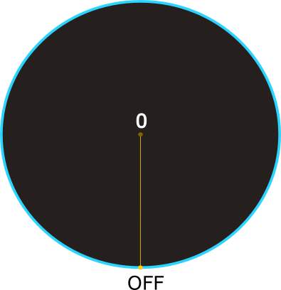
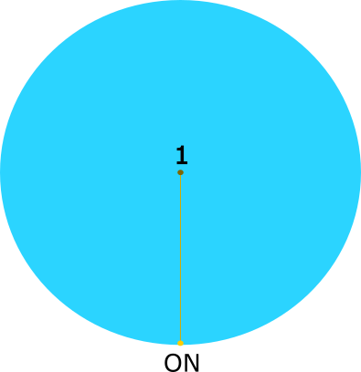
HOW DOES IT WORK?
Notes:
In classical computing, information is transferred using binary code: ones and zeros. You can think of binary code as a light switch that is either off or on, with off being a 0 and on being a 1. A classical bit can be either one of these at a single point in time.
Operations are then applied to these bits that modify them: these operations are irreversible, meaning that if you AND two bits together, the resulting bit cannot be ‘reversed’ to figure out what the input bits were.
A combination and sequency of these logic operations on millions of bits per second is what drives our computers. The development of classical algorithms makes use of logic operations to facilitate a particular task, such as the algorithm that is used to code library functions for division, multiplication, and so forth.

Slide 15
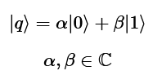
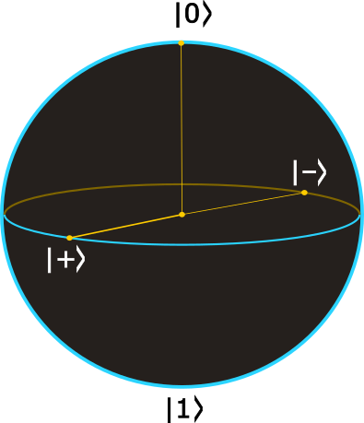
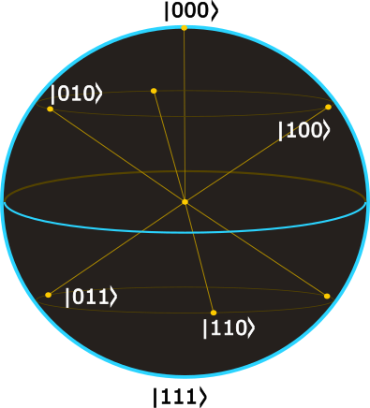
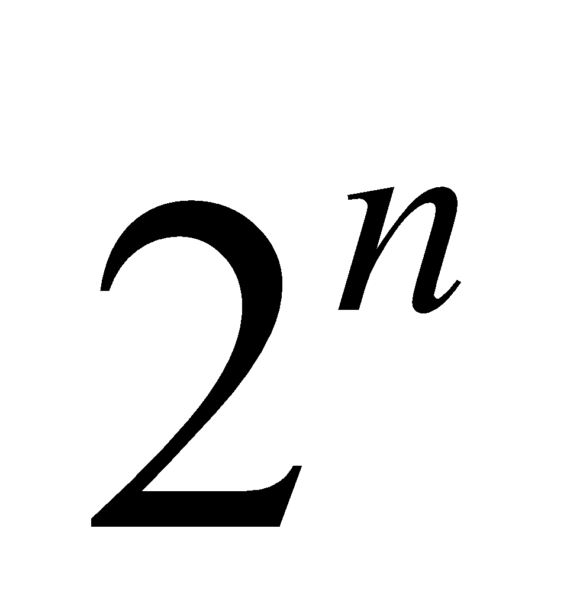
HOW DOES IT WORK?
Notes:
We’ve seen that a single classical bit can only be in one of two states at once. Increasing the number of bits increases the complexity of the system: for two bits, there are a total of four possible states for the system.
Now, let’s take a look at quantum bits. Think of quantum bits as a purely abstract thing for now: don’t worry about their hardware implementation. We’ll look at that later on!
Just like classical bits, quantum bits can also be one or zero: but they have the added ability to be both at once. This is called a superposition and is one of the major differences between the classical and quantum worlds. As you can see in the first drawing, quantum states can be represented on a sphere, with the 0 and 1 states at opposite poles.
Valid qubit states exist across the entire surface of the sphere. You will note that specific states lying on cartesian axes are illustrated here. There are some of the states the qubit can be in (the plus and minus states, in particular, denote simple superpositions) and we will cover these states more rigorously later.
The important thing to note is that the qubit can exist in a superposition of 0 and 1 at once: this doesn’t mean that it is BOTH zero and one at the same time, but rather that there is an inherent uncertainty about its state. This uncertainty is fundamental to quantum mechanics, and is a large part of the driving force behind the power of quantum computing.
The number of possible states a system can occupy increases as 2^n with the number, n of qubits in the system. This means that we have an exponential amount of states that can be included in a superposition. The ability to perform computation with superpositions of states is what gives quantum algorithms their edge over classical ones.

Slide 16

HOW DOES IT WORK?
Notes:
You can see the difference between classical and quantum bits in the animated maze solver. A classical algorithm, which can only make use of classical bits, will send (iteratively) a bit through the maze, exploring all possible options.
A quantum algorithm, in this case, a qubit superposition state is sent through the maze, allowing us to explore multiple pathways at once.
If a maze contains 99 dead ends and one solution, you would on average have to try 50 times to get to the correct solution. A quantum algorithm locate the solution pathway in roughly 10 tries.

Slide 17
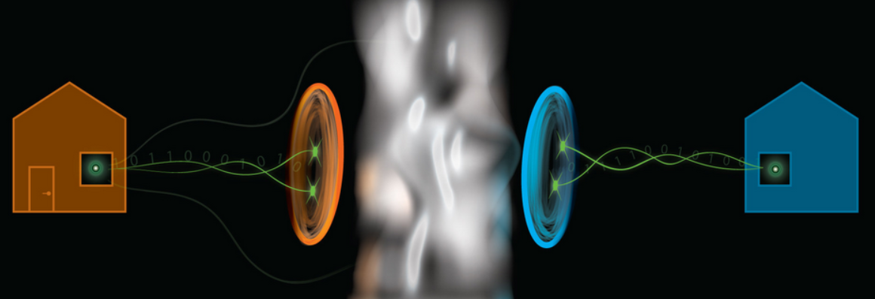
HOW DOES IT WORK?
Spooky Action at a Distance
Notes:
Entanglement is yet another special property of quantum objects.
*A coin is spinning. The coin is in a muddy, wet box resting on the ocean floor in the deepest part of the ocean. It's pitch black. Don't ask who set the coin spinning to begin with, or how it was brought down there —we're physicists, not storytellers! The point of this is that the coin has a twin spinning in an identical box on the surface of a cold, icy planet billions of light years away. Suddenly, the firs coin stops spinning and falls heads up. At the same instant, the second coin, far enough away that it would take light from our planet billions of years to reach it, will come up tails.*
How did the second coin 'know' what the first coin would do, and act accordingly? It's clear that no information was communicated, since information cannot travel faster than the speed of light. So what's going on?!
This 'spooky action at a distance' baffled Einstein so much that he rejected quantum physics! He thought the whole theory had to be wrong, because things like this just weren't possible.
Particles that know each other's state instantly in this way are said to be entangled. Entangled particles are very useful for quantum computers because the outcomes of their measurements are *correlated*. The entangled coins in the example above will always stop spinning (be measured) with their opposite sides facing up.
When it comes to particles in quantum circuits, a transformation that is applied to one particle in the set also indirectly affects the other particle, even if it is nowhere near the first particle physically. There are some really cool things that can be done because of this, such as teleportation! We’ll examine this a bit more later.

Slide 18
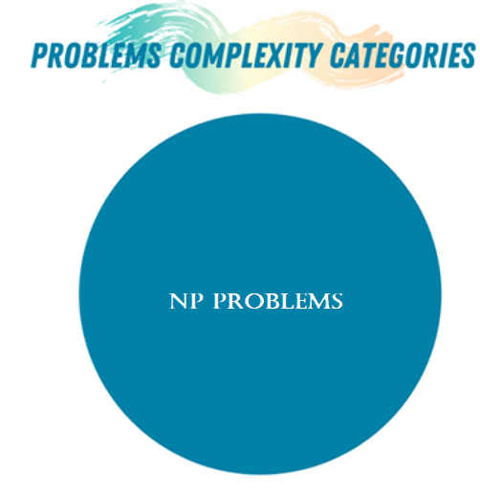

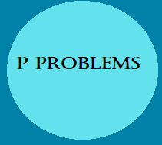
Problem Classes
Notes:
Let’s take a look at some fundamental concepts in computer science that will give us a slightly better understanding of the sort of problems that quantum computers are able to solve.
Within the computational complexity zoo, there are a few classes of problems of interest.

Slide 19

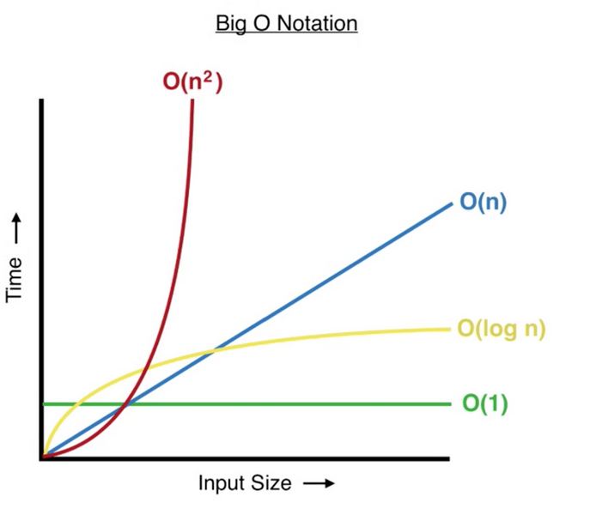
P Problems
multiplication
sorting
linear programming
Notes:
P problems are problems that can be solved efficiently on a classical computer: where the time to find a solution scales as a polynomial function based on the size of the input.
Some examples are multiplication, which is O(n) and sorting, which is O(nlogn)
Solving a system of linear equations is O(n^3)

Slide 20
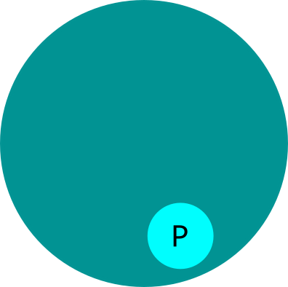
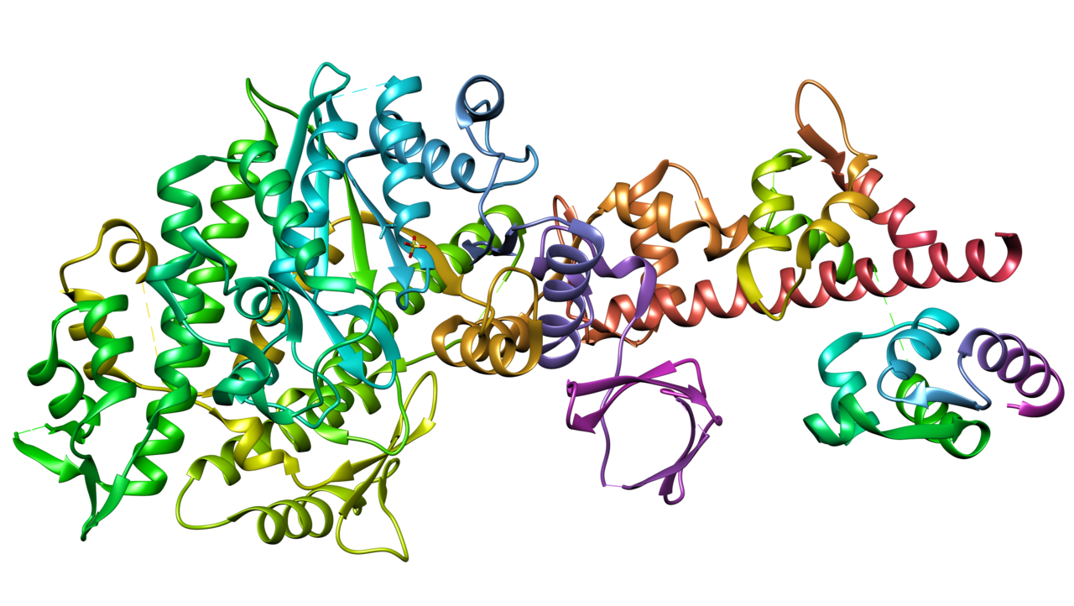
NP & NP-C Problems
Traveling Salesman
Steiner Tree
SAT
Factoring
Notes:
NP problems are a class of problems where a given solution can be verified in polynomial time, but the time taken to find a solution scales up exponentially with the size to the problem. NP complete problems are basically just a subclass of the really difficult NP problems.
Frustratingly, some of the most useful and interesting problems fall into this category, such as the traveling salesman problem, which shows up in vehicle routing algorithms,
Factoring is also in NP: which is why modern encryption standards are so secure. It is very easy to test if two numbers a factors of a larger number, but very hard to find those factors
satisfiability problems, which show up in circuit design, protein folding, and arbitrarily large Sudoku.
If an algorithm to any NP-C problem were to be found, a solution to all existing NP problems would also be found, collapsing the class of unsolvable problems.
So, what are the implications? If you discover a new algorithm for solving Sudoku really fast, let someone know!
This algorithm could solve protein folding & help cure cancer!

Slide 21
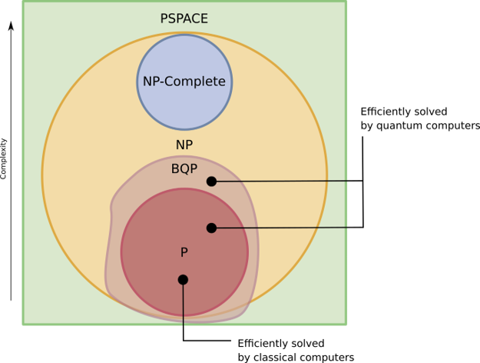
Where do Quantum Computers Fit In?
Notes:
There exists one solution that scientists have found to tackle solving NP problems in polynomial time, and that is through the use of quantum mechanics.
An efficient algorithm for integer factorization, an NP problems, was found in 1994 by Peter Shor. To create his algorithm, Shor exploited certain mathematical properties of composite numbers and their factors that are particularly well suited to producing the kind of constructive and destructive interference that a quantum computer can thrive on. The NP-complete problems do not seem to share those special properties. To this day, researchers have found only a few other quantum algorithms that appear to provide a speedup from exponential to polynomial time for a problem.
However, to date a quantum algorithm that can solve NP-complete problems efficiently has not been found, so we are still limited to using only a couple of algorithms. However, application of these algorithms is far reaching. For example, quantum computers can efficiently solve a ‘search’ problem using Grover’s algorithm, requiring on the order of Root(N) iterations (compared to N/2).
Recently, it was proven that quantum computers would be able to solve a class of problems that were completely inaccessible to classical computers: this class is called BQP. This class not only contains all P problems,and some NP problems, but also distinct problems that only quantum computers will be able to solve.
Very recently (this year!) a group of scientists compared quantum vs classical algorithms for verifying the solution to an NP-complete problem when provided with only a part of that solution, and proved that quantum computers would outperform classical ones.
So the field is constantly evolving, and our knowledge of what quantum computing can do is incomplete.

Slide 22
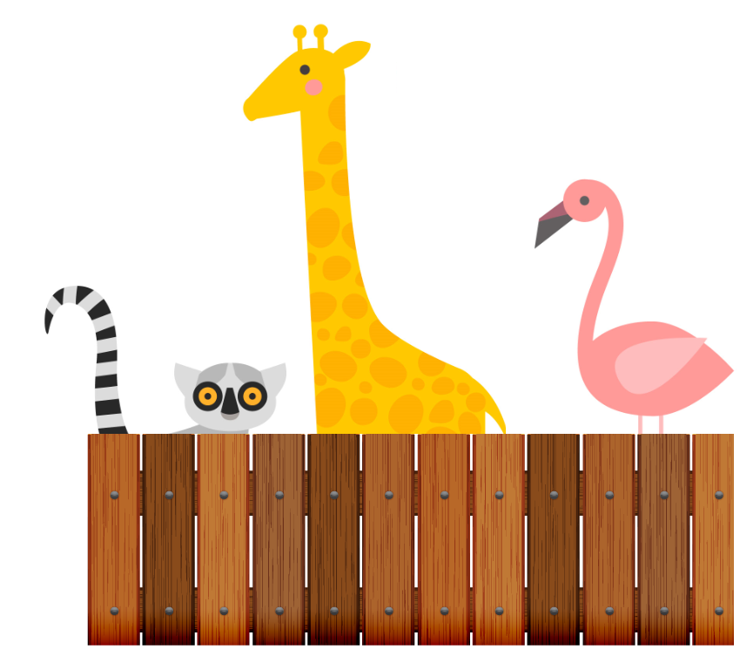
Our understanding of the complexity zoo is always expanding.

Slide 23
Check - In
On the scales below, annotate where on the scale how you are feeling based on the following prompt.
“I understand the difference between a classical bit and a qubit.”
“I understand the difference between the kinds of problems quantum computers can solve vs. classical computers.”
1
(what did you just talk about..?)
10
(I could comfortably explain this to my students right now)
10
(I could comfortably explain this to my students right now)

Slide 24
Interactive Break!
Think of some existing problems in your area of expertise that you think could be solved with a quantum computer. No answer is a wrong answer!
Input your thoughts into the interactive word cloud.

Slide 25
Superposition with
Fernand

Slide 26
Shortest Paths with Zhanna

Slide 27
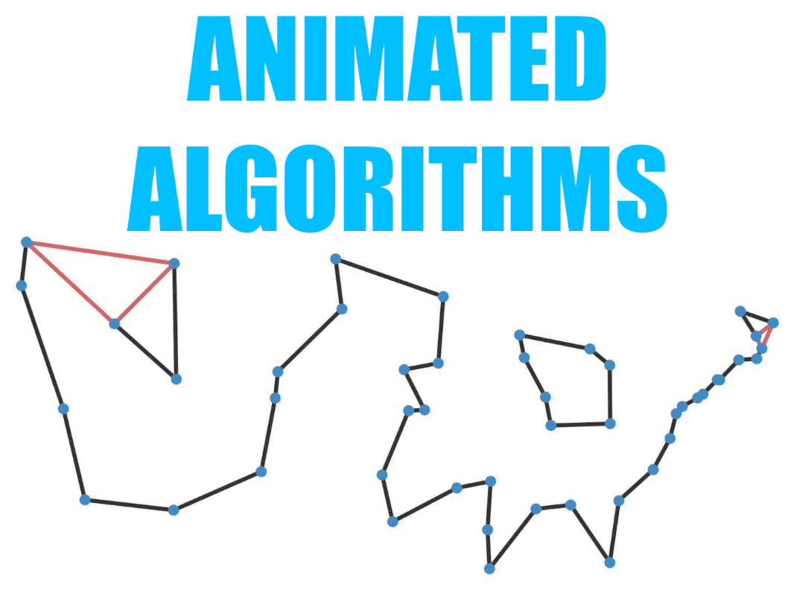
Traveling Salesman Problem
Let’s explore a common NP-class problem, and see how it can
be solved real time on a quantum computer!
Interactive Exercise

Slide 28
Traveling Salesman Problem
Use maps.google.com to help you plan a trip. Choose the most efficient path (shortest total time of travel)
Interactive Exercise
Trip 1: start in Boston, MA; Travel to Detroit, MI & Frankfort, KY
Trip 2: start in Boston, MA;Travel to Detroit, MI, Frankfort, KY & Evanston, IL
Trip 3: start in Boston, MA;Travel to Detroit, MI, Frankfort, KY, & Evanston, IL
Trip 4: start in Boston, MA;Travel to Detroit, MI, Frankfort, KY, Evanston, IL & Gulfport, MS
Trip 5: start in Boston, MA;Travel to Detroit, MI, Frankfort, KY, Evanston, IL, Gulfport, MS & Toronto, Canada
Notes:
Explain the traveling salesman (or shortest path) problem statement. Tell participants that they will simulate the problem-solving strategy used by a traditional computer and that their performance will be times.
Show how to add locations to Google Maps trip
The number of cities the participants will be asked to navigate will increase with each iteration and the time for the group to solve it will be recorded.
Record and graph usong Desmos (https://www.desmos.com/) the total travel time for each trip instance. Use the resulting graph to discuss the shortest path algorithm.

Slide 29


Guidelines
Now head to the quantum solver developed by Geering Up, and see
how you performed against the quantum annealer!
Interactive Exercise
We haven’t learned about a quantum annealer yet, but this is what we’ll be looking at in the next section.
Notes:
http://quantum-hub.herokuapp.com/app/tsp

Slide 30
Quantum Annealing with Ana

Slide 31
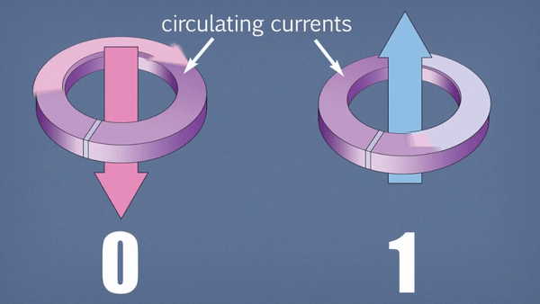
Quantum Annealing
Notes:
First of all, what is quantum annealing? Quantum annealing uses quantum fluctuations in cirucits of superconducting loops to find a minimum energy configuration. Optimization problems can be mapped to this system. The problem is encoded on to the quantum processor, and the system is allowed to evolve. The ground state energy of the system will represent the solution to the problem.
D-wave’s qubits are made of superconducting loops, which have a circulating current and corresponding magnetic field. A single qubit can in the 0 or 1 state but can also be in a superposition of these states.

Slide 32
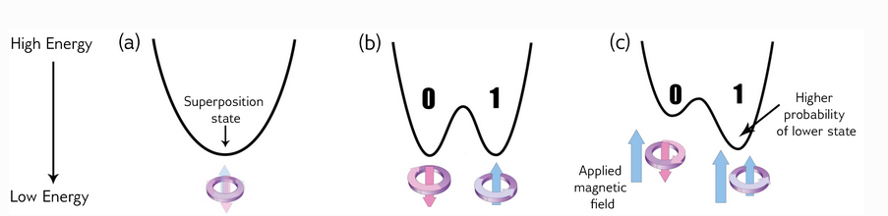
Single-Qubit Anneal Cycle Workflow
Notes:
Initially, a single qubit will start in a superposition state in the lowest energy configuration.
Gradually, the energy barrier is raised, forcing the qubit to collapse into one of two states at the end of the anneal process. As show, there is a 50% probability of the qubit falling in either state.
However, the probability of the qubit ending up in one of the valleys can be influenced by an applied magnetic field, which can tilt the potential. This magnetic field is externally applied and called a bias.

Slide 33
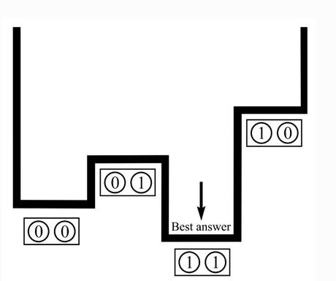
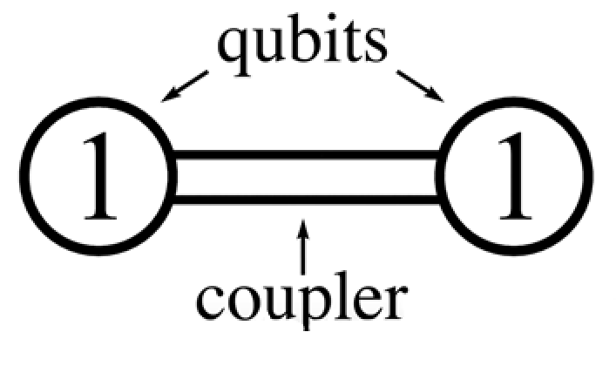
Many Coupled Qubits
Complex Solution Space
Notes:
So far, we’ve only looked at one qubit and the way a bias can be used to force a ‘decision’ in the superposition.
By making use of not only a bias but also a coupler, multiple qubits can be entangled together. The relative energy of each state will now depend on the applied bias as well as the coupling between qubit states. For example, the two-qubit system shown on the left of the slide is going to have four possible states : 00, 01, 10, 11. Depending on the applied bias, coupling strength, the time evolution of this system (in this case) will lead to the ground state being the 11 state.

Slide 34

How quantum annealing works:
A real-life problem is mathematically formulated
The problem is converted into bias and coupling strengths for qubit arrays on the QPU
The system begins in a ground state; then, the problem Hamiltonian is introduced
The system is allowed to evolve in time
Measurement is performed to determine a solution
The ground state energy represents the solution to your problem
Notes:
A classical Hamiltonian is a mathematical description of some physical system in terms of its energies. You can input any particular state of the system, and the Hamiltonian returns the energy for that state.
For a quantum system, a Hamiltonian is a function that maps certain states, called eigenstates, to energies. Only when the system is in an eigenstate of the Hamiltonian is its energy well defined and called the eigenenergy. When the system is in any other state, its energy is uncertain. The collection of eigenstates with defined eigenenergies make up the eigenspectrum.

Slide 35
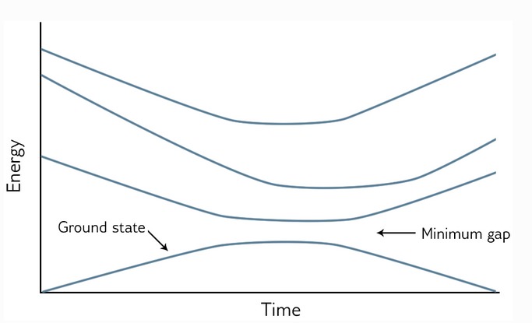
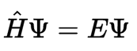
QPU System Evolution
Notes:
This is what the energy of the system looks like as a function of time. Each line represents a different energy eigenvalue of the system, and you can see the evolution of these states as a function of time. The anneal will begin with the system in the ground state, or the lowest-energy eigenstate, of the initial system Hamiltonian. This Hamiltonian maps the initial state of the system to the energy values shown at t=0 on this graph.
Then, the problem Hamiltonian is slowly introduced. The idea is to introduce this slowly enough that there is no influence from outside energy sources: this is called an adiabatic process.
Ideally, the system will remain in the ground energy state at all times during the anneal cycle, even if there are points where the other energy eigenstates approach the ground state in energy.
At the end of the cycle, the system will be in the minimum energy state of the problem Hamiltonian and will therefore correspond to a solution.
Let’s take a look at this process in steps.

Slide 36
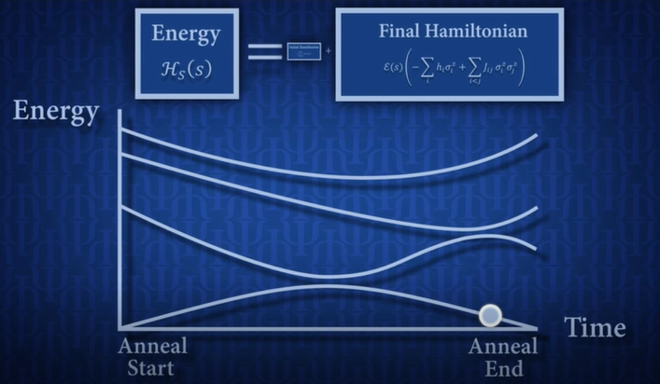
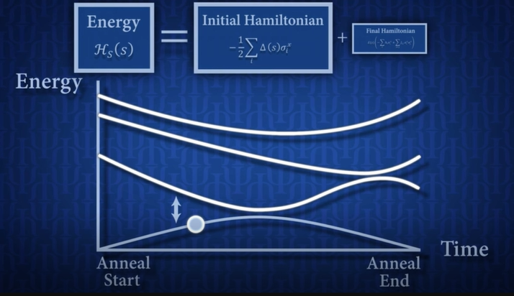
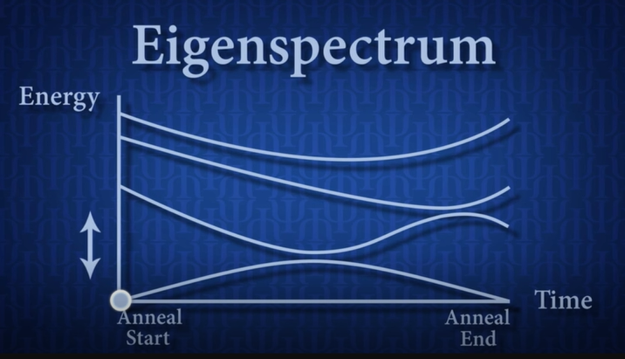
Avoided crossing

Slide 37
What problems
can be mapped?
Optimization Problems
Where the best solution out of many possible combinations needs to be found. This can be treated like an energy minimization problem.
• Common problems include scheduling, traveling salesman, sudoku
Sampling Problems
Sampling from low-energy can be useful for machine learning problems where you want to build a probabilistic model of reality.
• Common problems include most machine learning and AI applications used in mobile applications, commerce, defense, etc.
Notes:
Because quantum annealing processors naturally return low-energy solutions, problems that can be solved by annealing must therefore be structured in a way that maps this lowest energy state to a real problem solution. This limits the class of problems that annealing can realistically tackle.
• Volkswagen used D-Wave’s SDK for annealing to create software that finds the optimal cycle for color swaps during their car paining assembly line
• Menten AI used a hybrid optimization/machine learning approach to explore new sequences when designing peptides with enhanced drug properties.
• QxBranch is using quantum a machine learning to improve election forecasting, basing their model on the failure of polling to determine the 2016 US election.
• Researchers are looking at ways to predict market trends and financial crashes using a hybrid quantum/machine learning approach

Slide 38
Check - In
On the scales below, annotate where on the scale how you are feeling based on the following prompt.
“I understand .. what kinds of problems quantum annealing is used to solve”
“I understand...how quantum annealing maps mathematical problems to hardware”
1
(what did you just talk about..?)
10
(I could comfortably explain this to my students right now)
1
(what did you just talk about..?)
10
(I could comfortably explain this to my students right now)

Slide 39
Guided Activity: Zero Sum Subsets with Zhanna
Take a second to navigate to the link provided and complete the interactive activity inside your breakout rooms. An instructor will be available to guide you should you experience problems!
Notes:
https://github.com/dtquantumc/zeroSumSubset

Slide 40

Idea Pitch

Slide 41
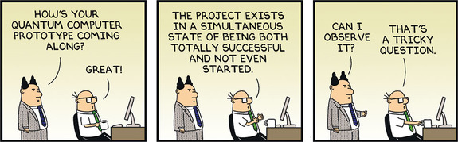
Shark Tank Idea Pitch
Your task: develop a 60 sec Shark Tank sales pitch aimed at raising funding for developing new QC technology.
Interactive Exercise
Notes:
QC areas:
Optimization & logistics
Search (extremely large data sets)
Constraint Satisfaction
Modeling & predictions of complex behaviors and interactions

Slide 42
Shark Tank Idea Pitch
Your task: develop a 60 sec Shark Tank sales pitch aimed at raising funding for developing new QC technology.
When thinking of applications consider the fields of:
Optimization & logistics
Search (extremely large data sets)
Constraint satisfaction
Modeling & predictions of complex behaviors and interactions
Interactive Exercise
Notes:
QC areas:
Optimization & logistics
Search (extremely large data sets)
Constraint Satisfaction
Modeling & predictions of complex behaviors and interactions

Slide 43
Lunch Break

Slide 44
Shark Tank Pitches

Slide 45
Shark Tank Pitches

Slide 46
Types of QC

Slide 47
Types of QC
Types of QC
• Often, when we think of ‘quantum computing’ we are thinking of a universal quantum computer, which does not exist yet.
• There are several steps on the way to achieving universal quantum computation, and many challenges that must be solved!
• Quantum annealing is but the first step on the journey.
• Noticeable quantum advantage already exists for these systems, which is very promising for future developments.
• We’re going to look at the steps towards universal quantum computation, as well as different approaches researchers have taken to create these systems!
Notes:
In the activity, you may have noticed that the D-wave processors provide a noticeable advantage in computation time over classical computer algorithms, namely, that computation time does not scale exponentially with the size of the problem.
This is a key finding!
Just two years ago, there was a lot of debate about whether quantum annealing had any noticeable advantages over classical systems. D-Wave has massively scaled up and improved the noise error on their systems in recent years, hitting a reliable noise mitigated 2000 qubit processor last year. This development directly led to experimental proof earlier this year that the processors provided a noticeable computational advantage. This became evident in the simulation of quantum magnetism and exotic matter states.
The reason D-Wave has the quantum computing power it does, is because its qubits are easier to initialize and couple than ‘”” real “” qubits.
Equally as significant as the performance milestone, said D-Wave's team, is the fact that the quantum annealing processors were used to run a practical application, instead of a proof-of-concept or an engineered, synthetic problem with little real-world relevance. Until now, quantum methods have mostly been leveraged to prove that the technology has the potential to solve practical problems, and is yet to make tangible marks in the real world.

Slide 48
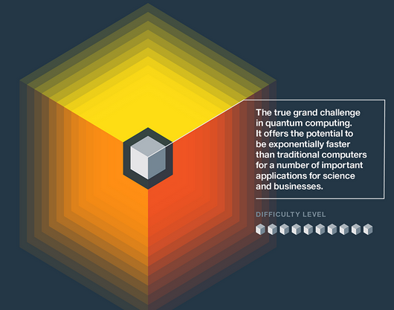
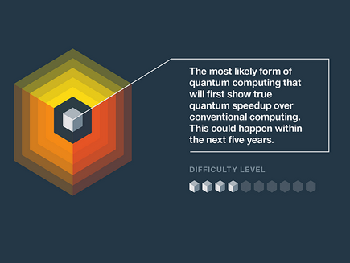
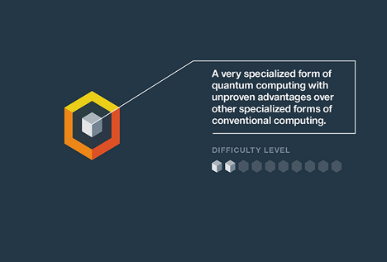


Notes:
Here’s a series of IBM’s predictions from 2019 about the three milestones on the QC path. The first of these, quantum annealing, relates to the procesors that D-Wave currently has in operation.
These processors have the advantage of being easier to control than other approaches to QCs, but they are limited in scope to the kinds of problems they can solve (optimization and sampling)
The next step, which is well underway, is the Analog Quantum phase. IBM has recently launched a processor with 65 qubits, and because it is so new the applications breadth and advantages are still unclear. Systems with this amount of qubits are predicted to hold a distinct advantage over supercomputing processors, to solve problems previously intractable. However, their power is still limited by the relatively small number of qubits.
Universal quantum is the ‘final frontier’ and the end goal for scientists. It is estimated that these computers will require 100K functioning qubits to unleash their power. However, there are significant challenges with entangling that many qubits at once, as well as mitigating noise.
Ultimately, even if Universal QC is a long way off, even intermediate state quantum computers will be useful in applications such as finance, chemistry, and medicine.

Slide 49
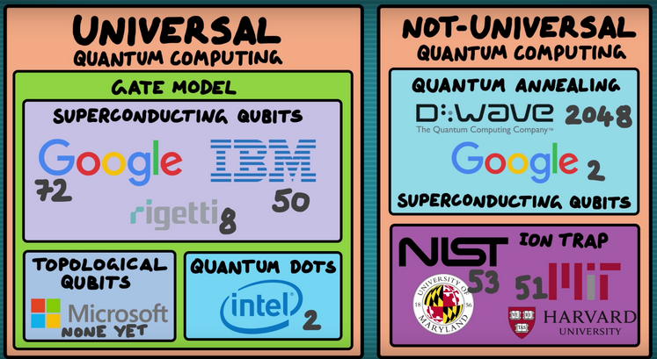
Notes:
So we’ve already talked about annealing, which falls into the category of a non-universal quantum computer, and uses superconducting loops to create its qubits
Let’s have a look at two other types of approaches towards universal QC, namely superconducting and ion-trap systems.
You've seen that objects exhibiting quantum behavior are either very small, very cold, or both. For example, when we took a look at the different types of quantum computing hardware, most of the implementations took advantage of quantum effects manifesting themselves in two ways:
1. Due to the size of the hardware
2. Due to the temperature of the hardware
Trapped-ion and semiconductor systems based on single electron spins require both of these criteria to be met. Superconducting systems, on the other hand, exploit macroscopic quantum phenomena, which occurs at low temperatures. Similarly, photonic systems do not require low temperatures because the quantum effects come about from the use of single photons at room temperature.

Slide 50
Check - In
On the scales below, annotate where on the scale how you are feeling based on the following prompt.
“I understand .. the difference between annealing and universal QC”
“I understand...how photonic quantum computing hardware works”
1
(what did you just talk about..?)
10
(I could comfortably explain this to my students right now)
1
(what did you just talk about..?)
10
(I could comfortably explain this to my students right now)

Slide 51
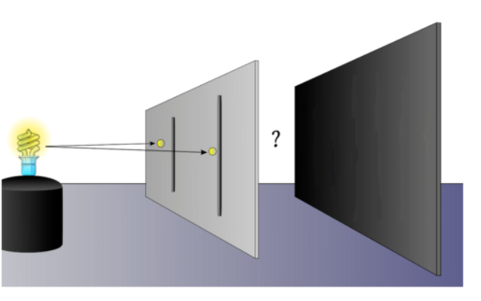
Notes:
According to classical physics, a single particle should go through either the left of the right slit, so there should only be a single bright spot on the screen. But here’s the crazy part—instead, the exact same interference pattern was observed.
A whole branch of physics, called quantum mechanics, had to be invented just to explain this! The only logical explanation is that the photon passes through both slits at once, then interferes with itself. This would mean that the single photon was behaving like a wave! This interference leads to peaks where the waves build up on each other, and troughs where the waves cancel each other out. This idea that the photon can be in multiple places at once is called superposition, and it’s a very important principle in quantum physics. The interference of two waves that causes a superposition is shown below.

Slide 52

Announcement
For the rest of the course, we will be making use of JupyterHub to access information and run code on a real quantum computer!
Please click the link provided to sign in to JupyterHub with your first name (the same you used to register for this workshop)
If you have any issues, please reach out to Ana!
Notes:
Add nbgitpuller link here:
http://34.145.36.19/hub/user-redirect/git-pull?repo=https%3A%2F%2Fgithub.com%2FWaywardPhoton%2FSTEMNYC_2021&urlpath=tree%2FSTEMNYC_2021%2F&branch=master

Slide 53

Wavefunctions
Navigate to the “Wavefunctions” notebook and open it.
Please have a look at the material within your discussion groups. Try answering the questions on your own during the next 5-10 minutes.
We’ll have a discussion when you return!

Slide 54
Wavefunctions
Where exactly was the electron just before it was measured to be in state C?
2. What do you think will happen if we measure the position of the electron again? Will it still be at point C or at any other point (say A,B and so on)?
Notes:
1. In the example above, before we actually measured the position of the electron, we were not sure where exactly the electron was. We say that this the electron is in a superposition state of all possible points that are predicted by the wavefunction. The probability of finding the electron at any specific point is determined by the wavefunction.
In the example of the car, we could exactly say where the car was one second before the measurement. We could also determine where the car will be one second after the measurement of its position. But what about the electron? So, where exactly was the electron located before we measured its position? The honest answer is that nobody knows! The probability distribution just says that the electron could be anywhere in that region (with some regions more favourable than others). The topic of where the electron was prior to measurement has been debated for over a century now and has puzzled the likes of Einstein, Bohr and many other great scientists!
2. Once we perform a measurement to determine the position of the electron, we say that the wavefunction has collapsed to that specific position (point C in the example above). Now even if we perform repeated measurements on the same electron, we will still find it only at position C. All the previous information about the probability distribution has been erased from its memory!

Slide 55
Superposition
Have a look at the “Kets” notebook for a refresher on linear algebra.
Then navigate to the “Superposition” notebook and open it.
Please have a look at the material within your discussion groups. Try answering the questions on your own during the next 5-10 minutes.
We’ll have a discussion when you return!
Notes:
Sarah 🡪 exit tickets
Assign one co-host for breakout rooms each

Slide 56
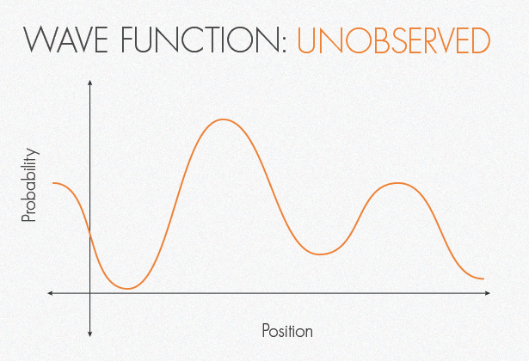
Measurement
Notes:
We’ve learned that a quantum superposition implies inherent uncertainty in measurement. Generally, when we measure a qubit we do so in the 0 1 basis that we have seen. There are many possible bases that exist: so specifying the basis the qubit is in, as well as the basis you are measuring in, is important! But we will only be using standard bases for the sake of time.
Let’s take a look at the [1 1 ] state. This state is in a supeposition of 0 and 1: what happens if it is measured? Well, the wavefunction of the state will “collapse” once it is observed into one of the two possible states, 0 or 1, with 50% probability (in this case).

Slide 57
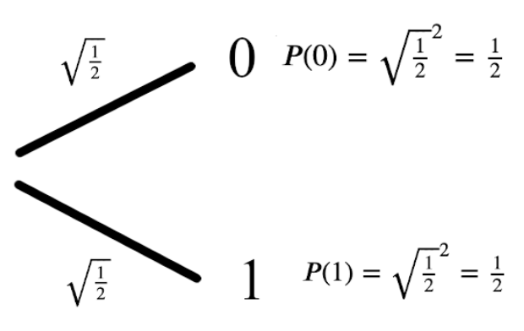



Measurement
Notes:
The 50% probability comes from the composition of the wavefunction. The amplitude squared of these compoentns a and b will give the probability.

Slide 58



Measurement

Slide 59
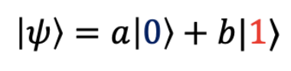
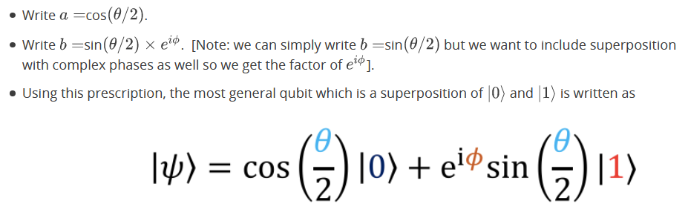
Bloch Sphere

Slide 60
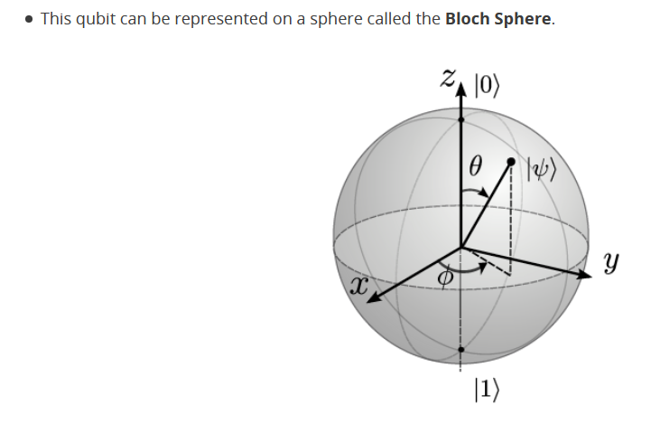
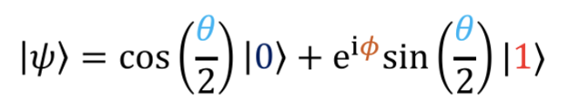
Bloch Sphere

Slide 61
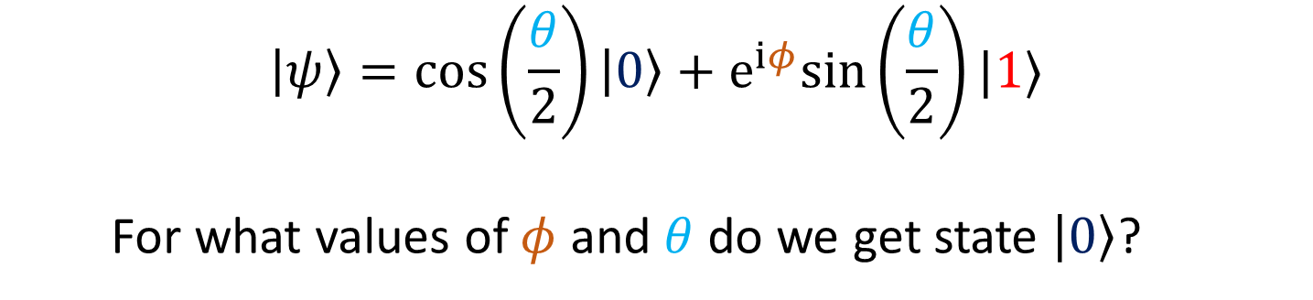
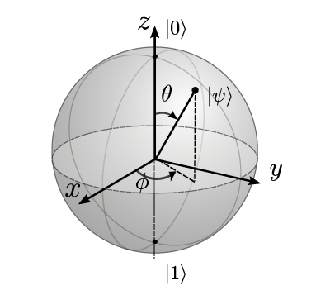





Bloch Sphere
Notes:
Give them 5 minutes to play with the question.

Slide 62

Announcement
For this part of the course, we’ll be making use of your IBMQ account to run code on a quantum simulator. Please make sure you have a (free) IBMQ account and have easy access to your API token.
If you’re having trouble running the code from your Jupyter notebook, run it directly in the Circuit Composer.

Slide 63
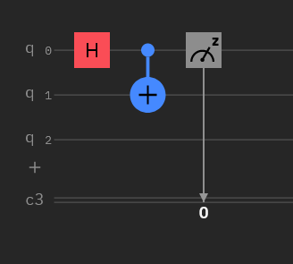



A quantum circuit is similar to a classical circuit!
Quantum Circuits

Slide 64









Slide 65
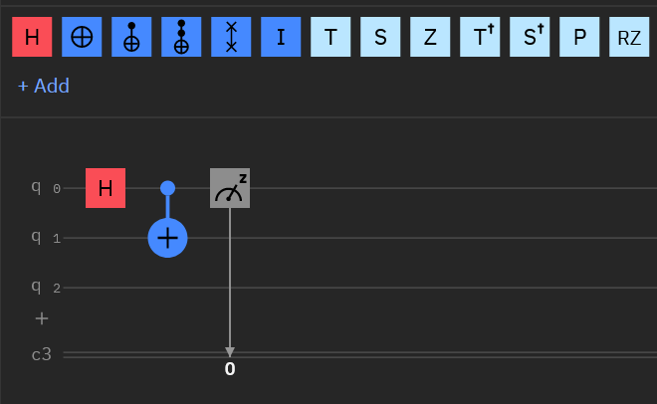
Quantum Circuits

Slide 66
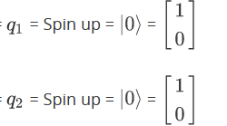
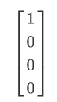
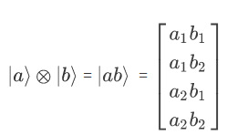
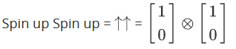
Single qubit gates are important, but we need to work with more than 1 qubit if we want to create anything useful.
We can represent a system of two qubits by applying a tensor product to the state space occupied by a single qubit.
Two-Qubit Gates

Slide 67
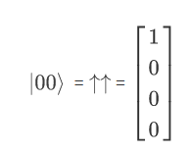
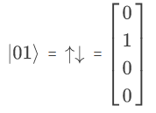
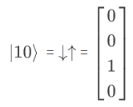
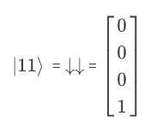
If we consider a system of two qubits, we will have four possible states:
Two-Qubit Gates
This represents the state of the qubits
This is a vector that gives an index for the joint state of the qubits.

Slide 68
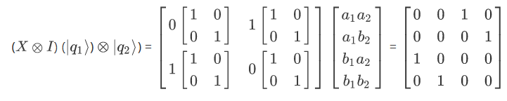
Two- Qubit Gates
Two-qubit operations can be created the same way, using the tensor
operator.
In this case, we are applying an X gate to the first qubit, and an I gate to the second qubit.
Multiplying the resulting matrix with any two qubit state will invert the state of the first qubit and leave the second qubit unchanged.

Slide 69
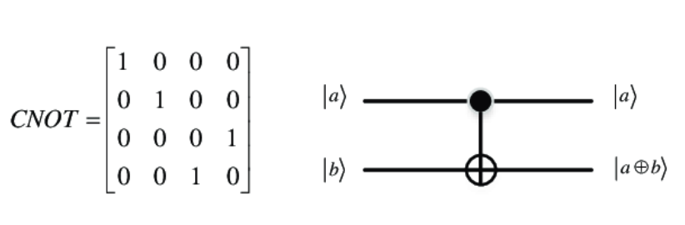

Now, we can introduce controlled gates, which apply a conditional transformation. The one we will be using is called the CNOT gate:
Gates
The CNOT gate will invert qubit |b> if qubit |a> is in the 1 state.
The CNOT becomes very useful for algorithms if it is applied when the control qubit (the |a>) is in a superposition.

Slide 70

Entangled State

Slide 71


Measurement of a Bell state will show that a correlation in the outcomes exists.
Entangled State
If we measure q2, then we get:

